Slide 1
LAMBDA:
ROBUSTNESS
& REUSABILITY

Slide 2
GISTS
GETTING STARTED

Slide 3
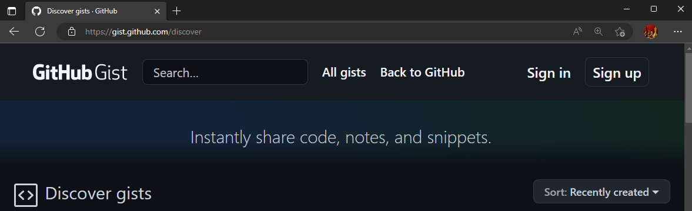
GISTS
GETTING STARTED
A simple way to share code snippets with others.
Go to https://gist.github.com
Sign in with a github account (or create one)

Slide 4
GISTS
CREATING A GIST

Slide 5
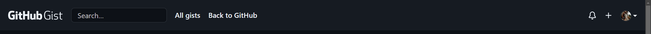

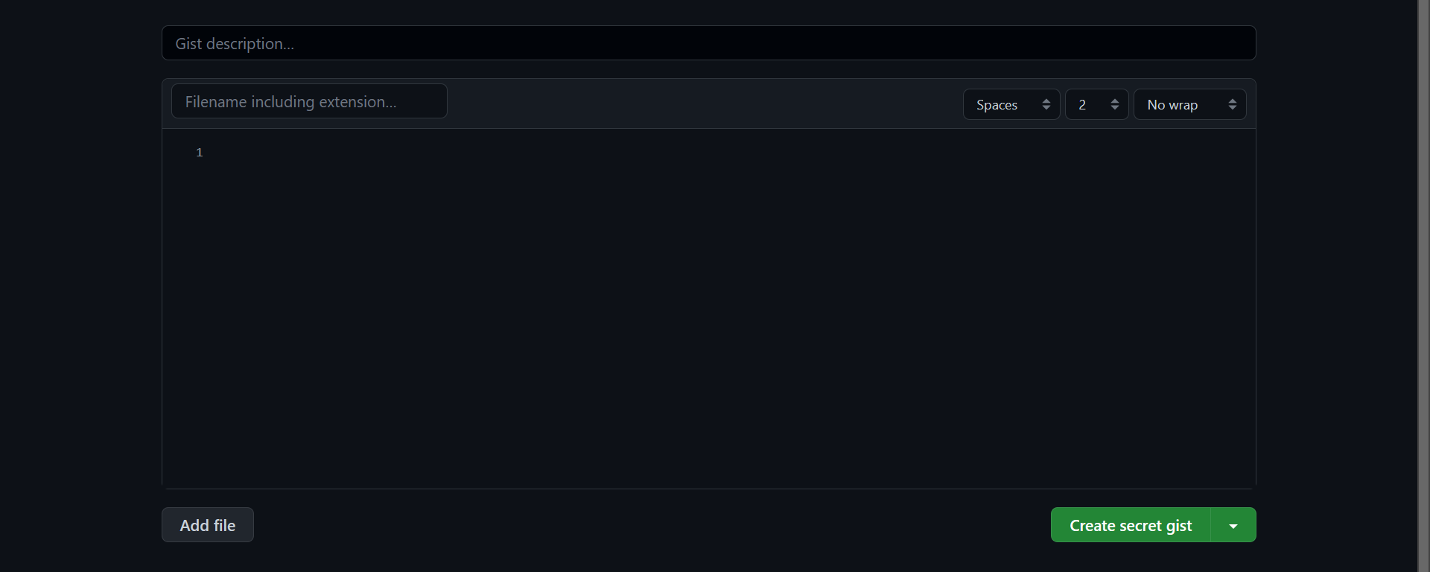
GISTS
CREATING A GIST
1. To create a new gist, log in and hit the + button in the top-right corner of the window

Slide 6

GISTS
CREATING A GIST
2. Enter a friendly description to tell others what the gist contains.

Slide 7

GISTS
CREATING A GIST
3. Enter a file name for the gist. I use one of:
excel-lambda-function-NAMEOFFUNCTION.txt
excel-lambda-module-NAMEOFMODULE.txt

Slide 8

GISTS
CREATING A GIST
4. Paste the definition of your LAMBDA functions in this format:
FUNCTIONNAME = LAMBDA(etc);
If you use ; as a list separator, use two ; after each function.

Slide 9
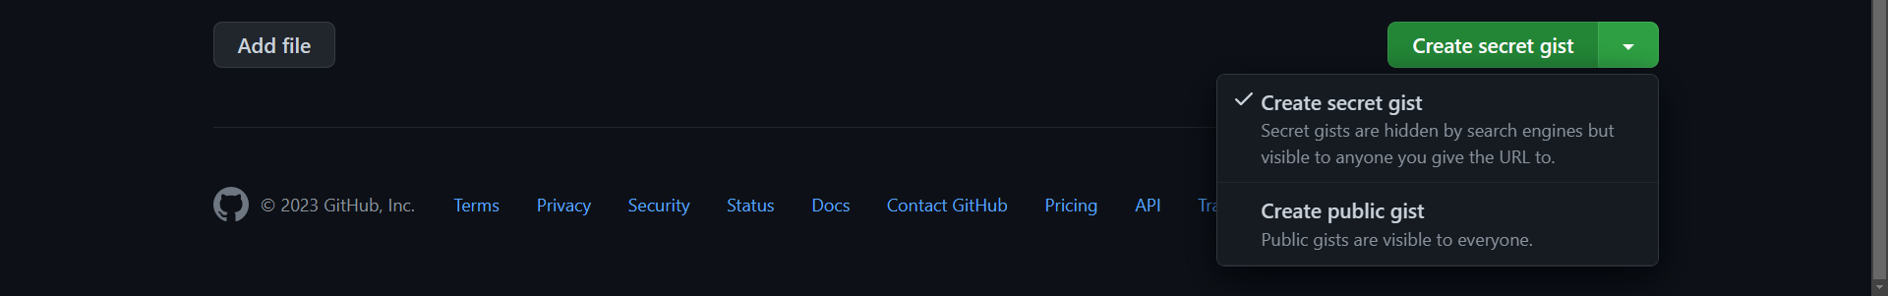

GISTS
CREATING A GIST
5. Select whether you want the gist to be “secret” or “public”.
Secret gists are visible to anyone who has the link but are not searchable.
Public gists are available to anyone and are searchable.

Slide 10
GISTS
CREATING A GIST
DEMO
Creating a gist
Adding more than one file
Secret vs. Public
Notes:
ADD = LAMBDA(a, b, a + b);
SUBTRACT = LAMBDA(a, b, a – b);

Slide 11
GISTS
USING A GIST

Slide 12
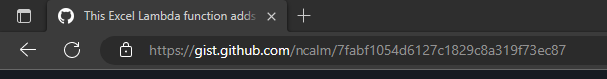
GISTS
USING A GIST
Copy the URL of the gist you want to use.

Slide 13
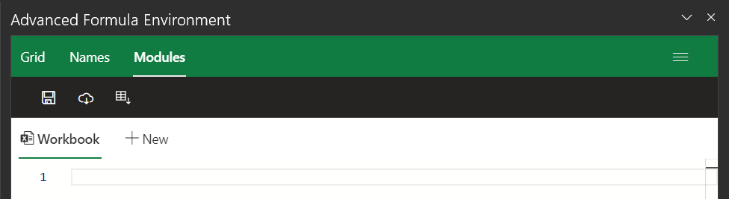
GISTS
USING A GIST
Copy the URL of the gist you want to use.
Use the “Import from URL” button in the Advanced Formula Environment

Slide 14
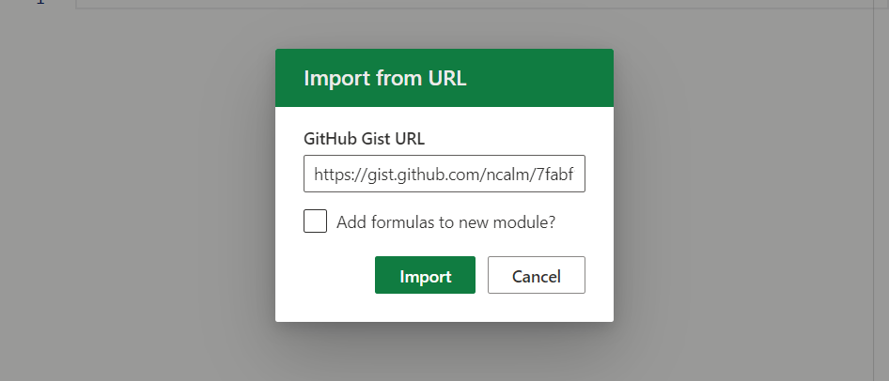
GISTS
USING A GIST
Copy the URL of the gist you want to use.
Use the “Import from URL” button in the Advanced Formula Environment
Paste the URL and optionally add the formulas to a new module. If not selected, the gist will be imported into the currently active module.

Slide 15
GISTS
USING A GIST
DEMO
Search of gists (user, filename)
Import to existing module
Import to new module
Import of multi-file gist
Import with conflict
Import of “malformed URL”
Notes:
filename:excel-lambda user:ncalm

Slide 16

GISTS
USING A GIST
TAKEAWAYS
Use a consistent file naming convention
Only use one file in each gist
“Secret” does not mean “Private”

Slide 17
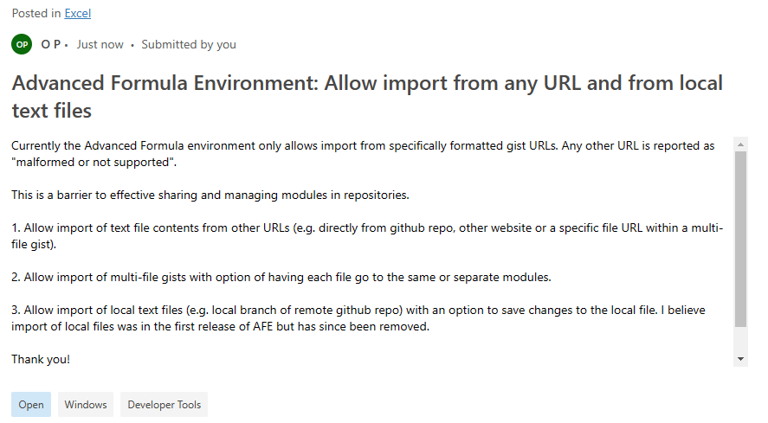

GISTS
REQUEST
Please vote for expanded import capabilities in AFE:

Slide 18
GISTS
USING GIT

Slide 19
GISTS
USING GIT
A gist is a git repository

Slide 20
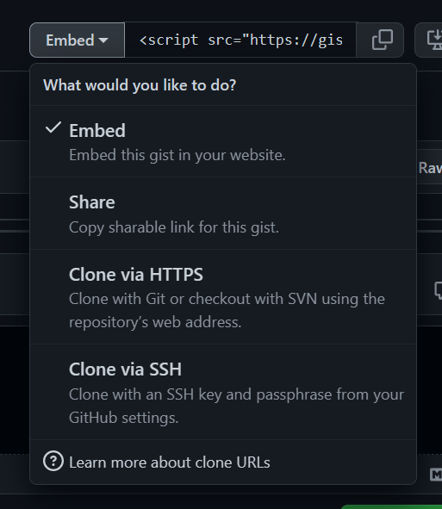
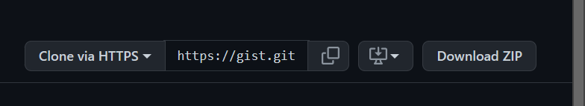
GISTS
USING GIT
Select “Clone via HTTPS” from the “Embed” menu of a gist to get the repository URL
Copy the repository URL

Slide 21
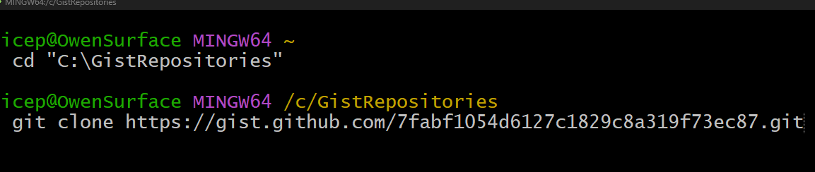
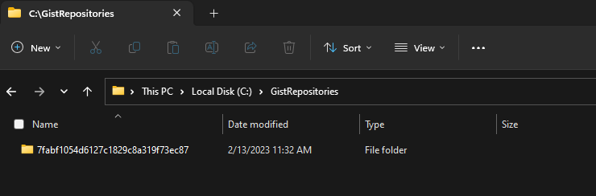
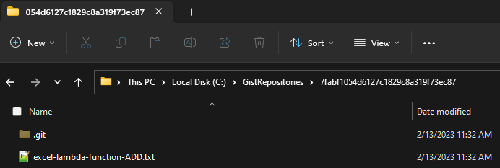
GISTS
USING GIT
Using your preferred method of interacting with git (shown here is “git bash”), clone the gist to a folder on your computer
A sub-folder named with the gist identifier will be added to the folder
The file(s) in your gist are now on your computer

Slide 22
GISTS
USING GIT
DEMO
Clone a gist
Edit an existing gist locally
Add a new file to a gist
Add, Commit, Push to remote

Slide 23
GISTS
USING GIT
Git command | description
git clone <gist URL> | Creates a local copy of the gist on your computer
(make edits locally)
git add . | After making changes to local file(s), adds the changed/added/deleted files to the working queue
git commit –m “message” | Commits the changes to the local repository
git push origin master | Pushes any differences between local and remote to the remote repository

Slide 24

GISTS
USING GIT
TAKEAWAYS
Clone a gist to your local computer
Make edits locally
Push changes to the URL
Download for
git bash

Slide 25
FUNCTION NAMES
NATIVE FUNCTIONS

Slide 26
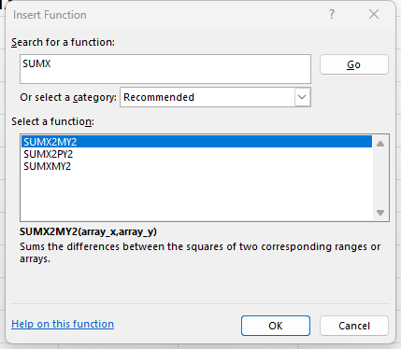
FUNCTION NAMES
NATIVE FUNCTIONS
All Excel functions are capitalized
Punctuation is not used (except period e.g. F.DIST.INV)
Names don’t conflict with references
Usually descriptive
Usually short
Not perfect

Slide 27
FUNCTION NAMES
LAMBDA FUNCTIONS

Slide 28
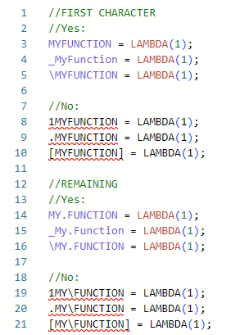
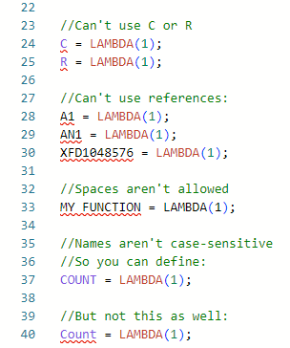
FUNCTION NAMES
LAMBDA FUNCTIONS
LAMBDA functions use the same syntax rules as Names
First character must be letter, underscore or backslash \
Remainder must be letters, numbers, periods or underscores
You can’t use C, or R as a name
You can’t use references
Spaces aren’t allowed
Names aren’t case-sensitive

Slide 29
FUNCTION NAMES
LAMBDA FUNCTIONS
DEMO
Duplication of native functions doesn’t work
Grouping of like functions using a period
Notes:
SUM = LAMBDA(range, REDUCE(0, range, LAMBDA(a, b, a + b));

Slide 30
FUNCTION NAMES
RECOMMENDATION
Function names:
Should be capitalized so they are easily distinguished from other names or LET variables
Should start with a letter so they are easy to type into the grid and other functions
Should use numbers sparingly and only to shorten the spelling of the number
Should use periods only to group like functions within a module (e.g. TEXT.SPLITTER)
Should not use underscores (mostly to make functions faster to type)
Should be meaningful. Don’t use TEXT.SPLIT when only splitting on spaces. Use TEXT.SPLITONSPACE instead.

Slide 31
MODULES
WHY TO USE THEM

Slide 32
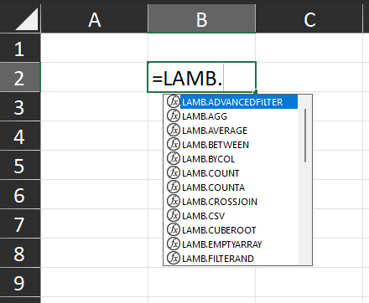
MODULES
WHY TO USE THEM
Avoid confusing LAMBDAs with native functions
Keep separate functions with the same name but different domains
Easily group functions around specific topics
Keep test functions separate from development
Keep functions by other developers separate
Easier to find when typing formulas

Slide 33
PARAMETERS
OPTIONAL PARAMS

Slide 34
PARAMETERS
OPTIONAL PARAMS
An optional parameter is enclosed in square brackets like this: [param]
A user can omit the parameter when using the function
If the user omits the parameter, ISOMITTED(param) returns TRUE
It’s up to you to control what happens when:
An optional parameter is supplied
An optional parameter is omitted

Slide 35
PARAMETERS
OPTIONAL PARAMS
DEMO
What happens when a non-optional parameter is omitted
Testing ISOMITTED
One-of two optional parameters
IFOMITTED
Notes:
ADD = LAMBDA(a, b, a + b);
#VALUE!
ADD = LAMBDA(a, b, IF(ISOMITTED(b), a, a+b));
#VALUE!
ADD = LAMBDA(a, [b], IF(ISOMITTED(b), a, a+b));
ADD = LAMBDA(a, [b], IF(ISOMITTED(b), a, a+b));

Slide 36
PARAMETERS
TYPES / DOMAINS

Slide 37
PARAMETERS
TYPES / DOMAINS
Usually, a parameter will expect a specific data type
Sometimes, a parameter may expect a limited domain of values
E.g. a numeric parameter that expects only numbers between 1 and 5
Unexpected values may produce confusing results
It’s up to you to control what happens when:
A value of the wrong data type is provided
An out-of-range value is provided

Slide 38
PARAMETERS
TYPES / DOMAINS
DEMO
Testing data types
Domain test

Slide 39

PARAMETERS
TAKEAWAYS
Non-optional params will cause #VALUE! if omitted
Use IFOMITTED for optional params
Test for correct types
Test for correct domains
Vote to add IFOMITTED to Excel

Slide 40
BUILDING BLOCKS

Slide 41
BUILDING BLOCKS
DEMO
Components of DESCRIBE
Lambda-ized native functions
FUNCS
STACKER
AGG
DESCRIBE

Slide 42
THANK YOU!

